Slide 1
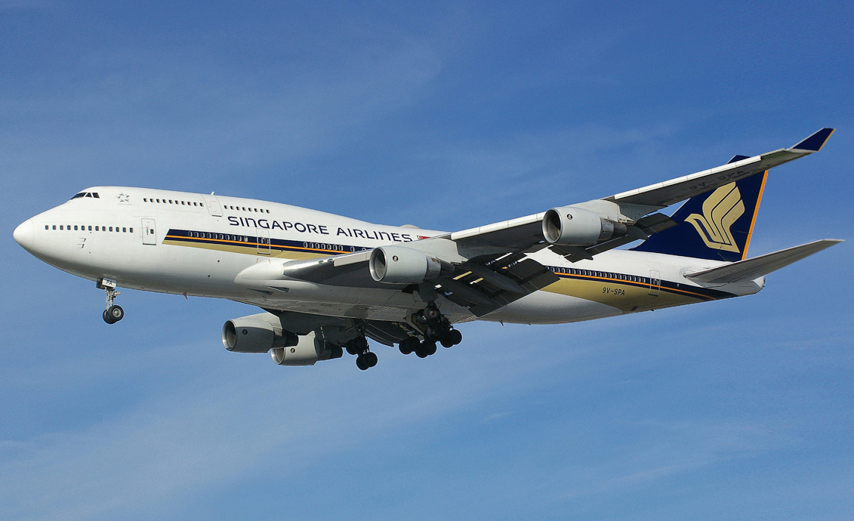
SIA APP CHALLENGE 2016 MYJOURNEY

Slide 2
1. Introduction to MyJourney
(what to add here?)

Slide 3
User Experience
I don’t know how to phrase these things but yall get my point right??? Minimize the cocks and maximize the yays (like exploring airport etc)
Minimize events that ruin a travel experience
MyJourney
Maximize functions that improves a travel experience

Slide 4
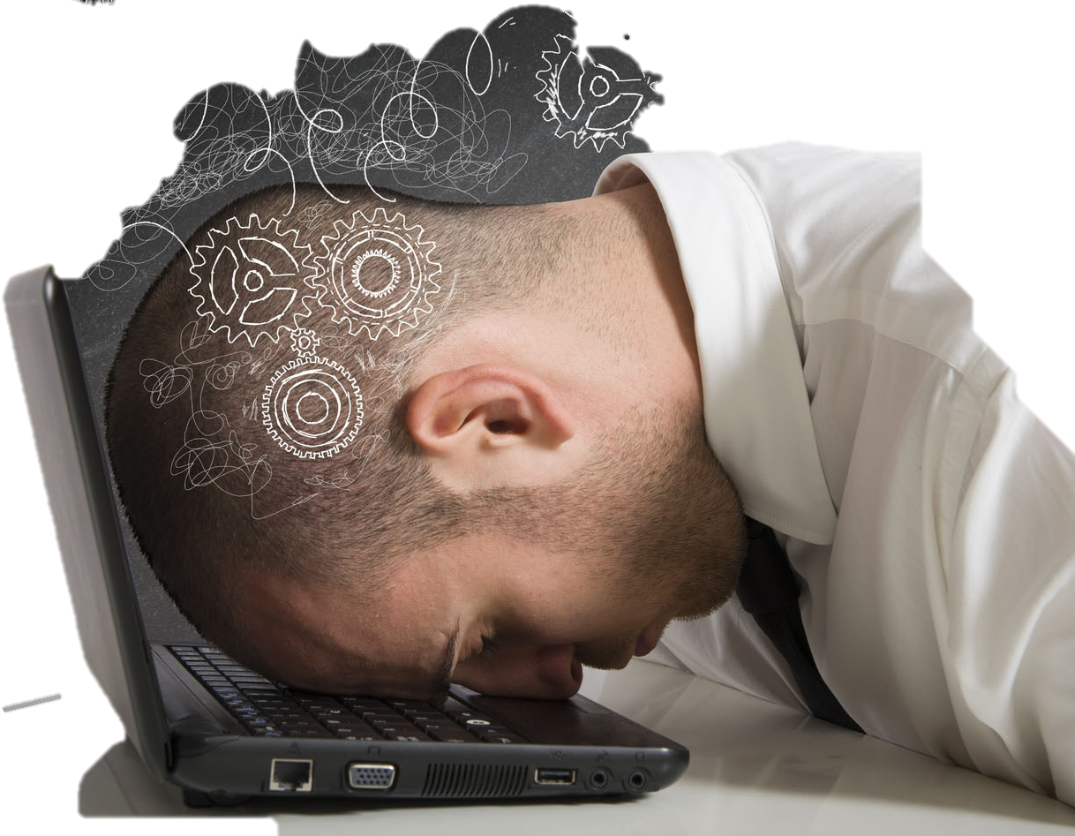
So what is MyJourney?
This page quite redundant but I’ll just leave it here
A platform with
Bla
Bla
Meant to help passengers not cock up and ruin their trip (link back to SIA and how they want to provide a good travel experience)

Slide 5
MyJourney main page
Talk about the different stages and how user has all the info relevant in each stage and how the stages progress and bla
Insert screenshot of main page. Either show all the headers only to demonstrate the different stages or show all of them open???

Slide 6
DEMONSTRATION
Random words

Slide 7
2. Future Extension
(what to add here?)

Slide 8
ACTIVITY AND LOCATION SUGGESTIONS
Blabla SIA earns commission bla
How app might look (simple)

Slide 9
TRAVEL BOOKINGS
Renting cars, booking taxis, etc. Commission once again
How app might look (simple)

Slide 10
Global reach
6 continents
35 countries
63 international
destinations

Slide 11
123,456,789,000$
123,456,789 users
100%
Just a page which I felt might be necessary to explain how SIA might benefit in the future
That’s a lot of money
And a lot of users
Total success!

Slide 12
THANKS!

Slide 13
Here you have a list of items
And some text
But remember not to overload your slides with content
You audience will listen to you or read the content, but won’t do both.

Slide 14
You can also split your content
White
Is the color of milk and fresh snow, the color produced by the combination of all the colors of the visible spectrum.
Black
Is the color of coal, ebony, and of outer space. It is the darkest color, the result of the absence of or complete absorption of light.

Slide 15
In two or three columns
Yellow
Is the color of gold, butter and ripe lemons. In the spectrum of visible light, yellow is found between green and orange.
Blue
Is the colour of the clear sky and the deep sea. It is located between violet and green on the optical spectrum.
Red
Is the color of blood, and because of this it has historically been associated with sacrifice, danger and courage.

Slide 16
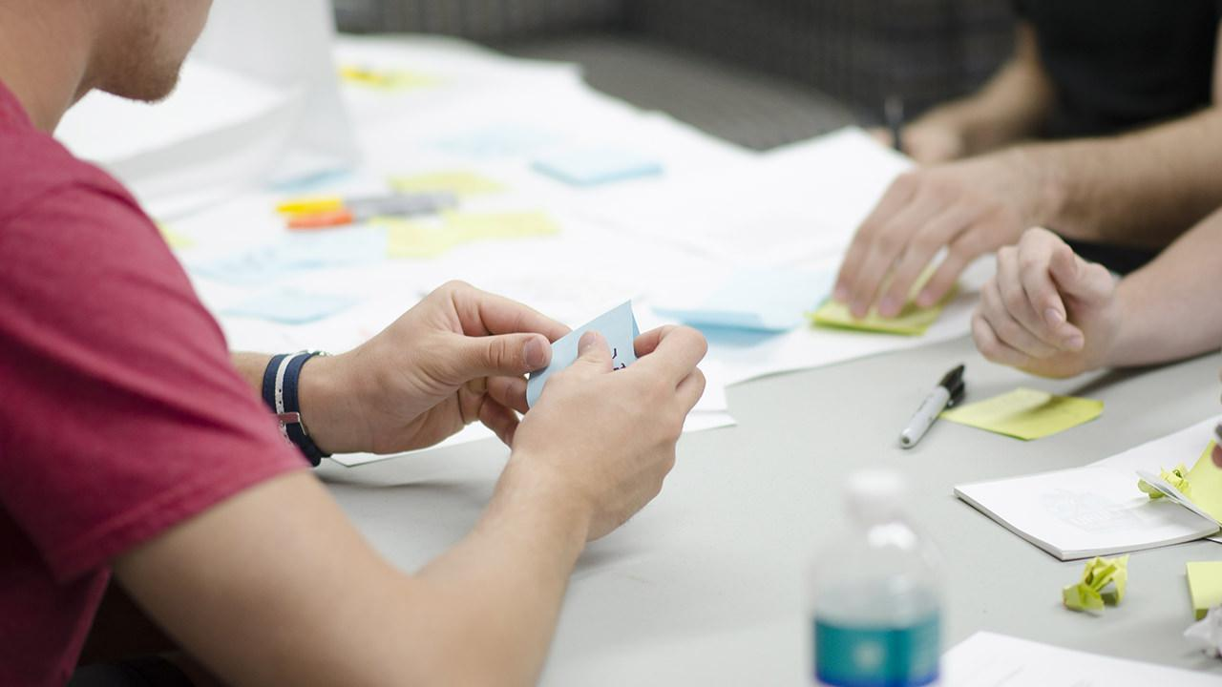
A picture is worth a thousand words
A complex idea can be conveyed with just a single still image, namely making it possible to absorb large amounts of data quickly.

Slide 17

Want big impact? USE BIG IMAGE

Slide 18
89,526,124
Whoa! That’s a big number, aren’t you proud?

Slide 19
Our process is easy
first
second
last

Slide 20
Let’s review some concepts
Yellow
Is the color of gold, butter and ripe lemons. In the spectrum of visible light, yellow is found between green and orange.
Blue
Is the colour of the clear sky and the deep sea. It is located between violet and green on the optical spectrum.
Red
Is the color of blood, and because of this it has historically been associated with sacrifice, danger and courage.
Yellow
Is the color of gold, butter and ripe lemons. In the spectrum of visible light, yellow is found between green and orange.
Blue
Is the colour of the clear sky and the deep sea. It is located between violet and green on the optical spectrum.
Red
Is the color of blood, and because of this it has historically been associated with sacrifice, danger and courage.

Slide 21
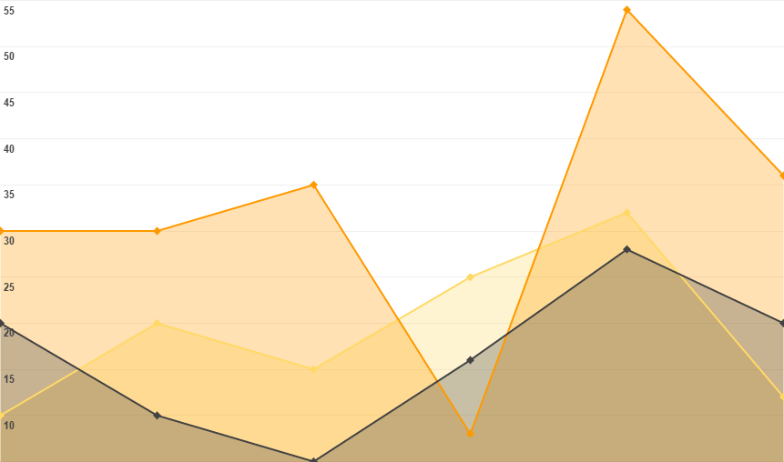
You can insert graphs from Google Sheets

Slide 22
ANDROID PROJECT
Show and explain your web, app or software projects using these gadget templates.
Place your screenshot here

Slide 23
SlidesCarnival icons are editable shapes.
This means that you can:
Resize them without losing quality.
Change line color, width and style.
Isn’t that nice? :)
Examples:

